Slide 1
Java script Basics

Slide 2
What is JavaScript?
A programming language of HTML specifically designed to work with Web browsers
It was developed to make interactive web frontend.
It is designed to be used for developing small programs – called scripts – that can be embedded in HTML Web pages
JavaScript is client side language, which was released in 1995 by Netscape with the help of Sun microsystems for Netscape-2 browser.
Who owns trademark of JS ----- Oracle
Java Script need a engine to convert code into machine language.
Every Browser has a javascript engine
JavaScript:
Is an interpreted language
Supports event-driven programming
Is object-based

Slide 3
Object Based?
Everything that JavaScript manipulates, it treats as an object – e.g. a links or a button etc.
An object has properties – e.g. a Margins, position, paddings, colors etc.
Properties are modified with methods.

Slide 4
Object-Based, Not Object-Oriented!
JavaScript is not a true object-oriented language like C++ or Java
It is so because it lacks two key features:
A formal inheritance mechanism
Strong typing
Nevertheless, JavaScript shares many similarities with object-oriented languages, and therefore is called an object-based language
4

Slide 5
Why JavaScript?
HTML is great for static Web pages; however, supports only rudimentary interactivity through forms and hyperlinks
JavaScript can be used (along with HTML) to develop interactive content for the Web

Slide 6
What java script can do?
Javascript Can Make Pages Alive
JavaScript Can Change HTML Content
JavaScript Can Change HTML Attributes
JavaScript Can Change HTML Styles (CSS)
JavaScript Can Validate Data

Slide 7
Some of things that JavaScript cannot do!
The following file ops. on the client computer:
Read -- Modify
Rename -- Delete
Create
Create graphics (although, it does have the ability to format pages through HTML - including the placement of graphics)
Any network programming bar one function: the ability to download a file to the browser specified through an arbitrary URL

Slide 8
Case Sensitivity
HTML is not case sensitive. The following mean the same to the browser:
<HTML> -- <html>
<Html> -- <htMl>
JavaScript is case sensitive. Only the first of the following will result in the desired function – the rest will generate an error or some other undesirable event:
onMouseClick -- OnMouseClick
onmouseclick -- ONMOUSECLICK

Slide 9
HTML DOM
The Document Object
When an HTML document is loaded into a web browser, it becomes a document object.
The document object is the root node of the HTML document and the "owner" of all other nodes: (element nodes, text nodes, attribute nodes, and comment nodes).
The document object provides properties and methods to access all node objects, from within JavaScript.

Slide 10
HTML DOM
The Attr Object
In the HTML DOM, the Attr object represents an HTML attribute.
An HTML attribute always belongs to an HTML element.

Slide 11
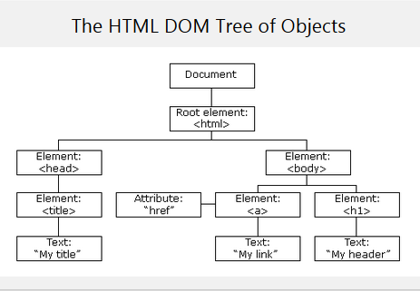

Slide 12
JavaScript Variables
Variables
Variables are containers for storing data (storing data values).
Ways to Declare a JavaScript Variable:
Using var (can’t have block scope)
Using let ( have block scope)
Using const (assigns constant value)

Slide 13
Examples
const pi = 3.14;
pi = 3.14159; Error: Assignment to a constant variable
const person = { name: 'John' };
person.age = 30; Valid, as the object itself is still mutable
let counter = 0;
counter = 1; Valid, as let allows reassignment
let message;
message = 'Hello, World!'; Valid, can be declared without an initial value

Slide 14
JavaScript Variables
Example
<script>
var x = 5;
var y = 6;
var z = x + y;
document.getElementById("demo").innerHTML =
"The value of z is: " + z;
</script>

Slide 15
Variable Type Conversion & Operations
String(number): This will convert number into string.
Number(string): This will convert string into number.
Boolean(number): This will return true.
Boolean(!number): This will return false.
JavaScript use triple equal sign for comparison as a===b and a!==b for not equal.

Slide 16
Alerts and prompts and confirm
Alert
Shows only text on screen
prompt
shows a message asking the user to input text. It returns the text.
confirm
shows a message and waits for the user to press

Slide 17
Alerts and prompts and confirm Examples
Alert
alert("Hello");
prompt
let age = prompt('How old are you?', 100);
alert(`You are ${age} years old!`);
Confirm
let isBoss = confirm("Are you the boss?");
alert( isBoss );

Slide 18
JavaScript Literals/primitives
A data value that appears directly in a statement
Literals can be of several types. Some of them are:
Number
String
Boolean
18

Slide 19
Numeric Literals
24
-230000000000000000
9.80665
1.67e-27
JavaScript stores all numbers, even integers, as floating-point numbers
19

Slide 20
String Literals
“”
‘’
‘Bhola’
“Where is the Bhola Continental Hotel?”
String literals are always enclosed in a matching pair of single or double quotes
20

Slide 21
Boolean Literals
true
false
if ( tankFull == false)
addMoreWater = true
21

Slide 22
JavaScript Operators
Operators operate on operands to achieve the desired results
JavaScript has numerous operators, classified in many categories. We will look at only a few of them belonging to the following categories:
Assignment operators
Arithmetic operators
Comparison operators
String operators
Logical operators
22

Slide 23
Assignment Operator “=” Changes the value of what is on the LHS, w.r.t. what is on the RHS
total_number_of_students = 984 ;
title = “Understanding Computers” ;
swapFlag = false ;
x = y + 33 ;
23

Slide 24
Arithmetic Operators
Multiply 2 * 4 → 8
Divide 2 / 4 → 0.5
Modulus 5 % 2 → 1
Add 2 + 4 → 6
Subtract 2 - 4 → -2
Negate -(5) → -5
24

Slide 25
Comparison Operators
Not the same as the assignment “=” operator
The “equal to (==)” Comparison Operator
if ( today == “Sunday” )
document.write(“The shop is closed”);
The string “The shop is closed” will be written to the document only if the variable today has a value equal to “Sunday”
25

Slide 26
Comparison Operators
a == b True if a and b are the same
a != b True if a and b are not the same
a > b True if a is greater than b
a >= b True if a is greater than or equal to b
a < b True if a is less than b
a <= b True if a is less than or equal to b
26

Slide 27
Example
if ( x != 0 )
result = y / x;
else
result = “not defined”;
27

Slide 28
Logical Operators Operate on Boolean expressions or variables
The “AND (&&)” Logical Operator
if ( (pitch == “hard”) && (bowler == “fast”) )
myStatus = “Pulled muscle”;
The value of the variable myStatus will be set to “Pulled muscle” if both of the conditions are true
28

Slide 29
Logical Operators
a && b AND True if both are true
a || b OR True of either or both are true
!a NOT True if a is false
29

Slide 30
Example
if ( x || y )
document.write (“Either or both are true”);
else
document.write (“Both are false”);
30

Slide 31
So far we have looked at the assignment operator, arithmetic operators, comparison operators and logical operators The final category that we are going to look at is string operators In that category, we look at only one, the concatenation operator
31

Slide 32
The “+” String Operator
The “+” operator can be used to concatenate two strings
title = “bhola” + “continental”
The value of the variable title becomes “bholacontinental”
32

Slide 33
Semicolon ;
Terminate all JavaScript statements with a semicolon. It is not always necessary, but highly recommended.
a = 23 ;
quotient = floor( a / 2) ;
remainder = a % 2 ;
33

Slide 34
Elements of JavaScript Statements
b = 2;
sum = sum + 49;
name = “Bhola” + “ Continental”;
x = Math.floor ( x );
Identifiers
Operators
Literals
Punctuation
34

Slide 35
Two more elements that are found in JavaScript statements are white spaces and line breaks
35

Slide 36
White Spaces & Line Breaks
White spaces: The space & the tab characters
JavaScript ignores any extra white spaces or line breaks that you put in the code
This gives you the freedom of using them for making your code appear neat and readable
36

Slide 37
Comments
Comments are included on a Web page to explain how and why you wrote the page the way you did
Comments can help someone other than the author to follow the logic of the page in the author’s absence
The commented text is neither displayed in the browser nor does it have any effect on the logical performance of the Web page, and is visible only when the actual code is viewed
37

Slide 38
JavaScript Comments
Single-line comments (two options)
// Author: Bhola
<!-- Creation Date: 24 March 2003
Multi-line comments
/* Author: Bhola
Creation Date: 24 March 2003 */
38

Slide 39
HTML Comments
<!-- Author: Bhola
Creation Date: 24 March 2003 -->
39

Slide 40
comments add clarity!
40

Slide 41
comments let the code speak for itself!
41

Slide 42
Strings in JS
String
A JavaScript string is zero or more characters written inside quotes.
Examples
let carName1 = "Volvo XC60"; // Double quotes
let carName2 = 'Volvo XC60'; // Single quotes

Slide 43
Strings in JS
Escape Characters
Because strings must be written within quotes, JavaScript will misunderstand this string:
let text = "We are the so-called "Vikings" from the north.";
The string will be chopped to "We are the so-called ".
The solution to avoid this problem, is to use the backslash escape character.
The backslash (\) escape character turns special characters into string characters:
Examples
\” \’ \\

Slide 44
String methods in JS
String methods
String methods help you to work with strings.
String methods are built in functions that provides support to the developer to work faster and smarter.
Examples
let txt = "ABCDEFGHIJKLMNOPQRSTUVWXYZ"; let length = txt.length;

Slide 45
String methods Examples
Slice() Methods
Extracts part of a string
example
let str = "Apple, Banana, Kiwi"; let part = str.slice(7, 13);
Replace method
Replaces specified values.
let text = "Please visit Microsoft!"; let newText = text.replace("Microsoft", "W3Schools");

Slide 46
String methods Examples
Replace method
By default it is case sensitive use regular expression.
To replace multiple values use regular expression.
Example
let text = "Please visit Microsoft!"; let newText = text.replace(/MICROSOFT/i, "W3Schools");
let text = "Please visit Microsoft and Microsoft!"; let newText = text.replace(/Microsoft/g, "W3Schools");

Slide 47
Several String methods
Use the {$} sign to get a value from a variable in string as ‘Your nam is ${name}’
str.length
toUpperCase()
toLowerCase()
Indexof(“word here”)
Indexoflast(“last index of multiple words”)
Trim()

Slide 48
Several String methods
str.replace(first match of x, with y) // replace(“school”, “collage”)
str.concat(str1,str2,…) //same as adding string(+)
str.split(“seperator”) //converts strings to an array
str.includes(“value”) //retrun true if value is available in str
str.startsWith(“value”) // return true if str start with value
str.endsWith(“value”) //return true if str ends with value

Slide 49
String and String Methods
str1.indexOf(str2); // indexOf() method checks if str2 is found within str1 and returns the index of the first occurrence. If str2 is not found in str1, indexOf will return -1.

Slide 50
Numbers Methods
Num.toFixed(numOfDecimalPlaces)
let price = 2.3433
price.toFixed(2) = > 2.34
Number(value To Convert To Number)
let price = “34.5”
Number(price) =>34.5
num.toString() //convert num to string
let price = 3.4
price.toString(price) => 3.4
parseInt(val) // returns whole number
let price 3.4445
parseInt(price) => 3

Slide 51
Math Class
JavaScript use the Math class to perform arithmetic function like power, max or min: Math.pow(x,y)
Math.random
Math.random() // generate number between 0(inclusive) to 1(exclusive)
Math.random() * 10 // between 0(in) to 10 (ex): 0-9
Math.random() * 11 // between 0(in) to 11 (ex): 0-10
[Math.random()* (max – min + 1)] + min

Slide 52
Ternary Operators
The conditional (ternary) operator takes three operands:
a condition followed by a question mark (?),
then an expression to execute if the condition is truthy followed by a colon (:),
finally the expression to execute if the condition is falsy.
condition ? exprIfTrue : exprIfFalse
This operator is frequently used as an alternative to an if…else statement.
const age = 26;
const beverage = age >= 21 ? "Beer" : "Juice";
console.log(beverage);
Use of double condition(if – else if - else)
Let z = ( x < y ) ? “less”: (x === y) ? “equal” : “bigger”

Slide 53
Control Structures
Control structures are use for decision making.
We use different conditional statements to do this.
If
If-else
Else-if etc.

Slide 54
Control Structures if
<p>Display "Good day!" if the hour is less than 18:00:</p>
<p id="demo">Good Evening!</p>
<script>
if (new Date().getHours() < 18) {
document.getElementById("demo").innerHTML = "Good day!";
}
</script>

Slide 55
Control structure if-else
<p id="demo"></p>
<script>
const hour = new Date().getHours();
let greeting;
if (hour < 18) {
greeting = "Good day";
} else {
greeting = "Good evening";
}
document.getElementById("demo").innerHTML = greeting;
</script>

Slide 56
Control structure else if
<p id="demo"></p>
<script>
const time = new Date().getHours();
let greeting;
if (time < 10) {
greeting = "Good morning";
} else if (time < 20) {
greeting = "Good day";
} else {
greeting = "Good evening";
}
document.getElementById("demo").innerHTML = greeting;
</script>

Slide 57
Loop structure
Loops can execute a block of code a number of times.
Loops are handy, if you want to run the same code over and over again, each time with a different value.
Types of loops
For loop
While loop

Slide 58
While Loop: Example
x = 1 ;
while ( x < 6000 ) {
document.write ( x ) ;
x = x + 1 ;
}
58

Slide 59
Decimal to Binary Conversion in JavaScript
x = 75 ; // x is the decimal number
y = “” ; // y is the binary equivalent
while ( x > 0 ) {
remainder = x % 2 ;
quotient = Math.floor( x / 2 ) ;
y = remainder + y ;
x = quotient ;
}
document.write( “y = ” + y ) ;
59

Slide 60
for: Example 1
Initial count
Condition
Operation
for ( x = 1 ; x < 6000 ; x = x + 1 ) {
document.write ( x ) ;
}
60

Slide 61
for: Description (1)
The ‘for’ loop starts by initializing the counter variable (which in this case is x)
The initial value in this case is ‘1’, but can be any other positive or negative number as well
Next the ‘for’ loop checks the condition. If the condition evaluates to a ‘true’ value, the ‘for’ loop goes through the loop once
61

Slide 62
for: Description (2)
After reaching the end of that iteration, the ‘for’ loop goes to the top once again, performs the operation, checks the condition
If the condition evaluates to a ‘false’ value, the ‘for’ loop finishes looping
Otherwise, the ‘for’ loop goes through the loop once again
Repeat from step 4
62

Slide 63
for: Example 2
for ( x = 99 ; x < 6000 ; x = x + 1 ) {
document.write ( x ) ;
}
63

Slide 64
for: Example 3
for ( x = 6000 ; x > 0 ; x = x - 1 ) {
document.write ( x ) ;
}
How many iterations would this ‘for’ loop run for?
6000?
64

Slide 65
for: Example 4
for ( x = 6000 ; x < 0 ; x = x - 1 ) {
document.write ( x ) ;
}
How many iterations would this ‘for’ loop run for?
None?
65

Slide 66
For Loop
<p id="demo"></p>
<script>
const cars = ["BMW", "Volvo", "Saab", "Ford", "Fiat", "Audi"];
let text = "";
for (let i = 0; i < cars.length; i++) {
text += cars[i] + "<br>";
}
document.getElementById("demo").innerHTML = text;
</script>

Slide 67
?
for while
67

Slide 68
for --?-- while
When the exact number of iterations is known, use the ‘for’ loop
When the number of iterations depend upon a condition being met, use the ‘while’ loop
68

Slide 69
‘for’ loops become especially useful when used in conjunction with arrays We’ll find out about arrays next time, and we’ll probe their usefulness as part of ‘for’ loop structures
69

Slide 70
Java script Basics cont…

Slide 71
Functions in JavaScript
A JavaScript function is a block of code designed to perform a particular task.
A JavaScript function is executed when "something" invokes it (calls it).

Slide 72
Why use Functions
You can reuse code( Define the code once, and use it many times).
You can use the same code many times with different arguments, to produce different results.

Slide 73
Function
A JavaScript function is defined with the function keyword, followed by a name, followed by parentheses ().
Syntax
function name(parameter1, parameter2, parameter3) { // code to be executed }
Function in JavaScript can be declared as
function functionName() {} //named function
const functionName = function(){} //anonymous function
const functionName = () =>{} //arrow function
function multiply(a, b = 1) {
return a * b;
}
multiply(5);

Slide 74
Functions in JS examples
function myFunction(p1, p2) {
return p1 * p2;
}
document.getElementById("demo").innerHTML = myFunction(4, 3);
Another example
var x = myFunction(4, 3);
document.getElementById("demo").innerHTML = x;
function myFunction(a, b) {
return a * b;
}

Slide 75
Named Function
In JavaScript, you can declare a normal function using the keyword function before function declaration.
function map(f, a) {
const result = new Array(a.length);
for (let i = 0; i < a.length; i++) {
result[i] = f(a[i]);
}
return result;
}
const f = function (x) {
return x * x * x;
};
const numbers = [0, 1, 2, 5, 10];
const cube = map(f, numbers);
console.log(cube);

Slide 76
Anonymous Function
Anonymous, meaning the function has no name. Function expressions are usually assigned to a variable, and can be anonymous, meaning the function has no name.
Normally function declarations load into the execution context before any code runs. This is known as hoisting, meaning you can use the function before you declare it.
Attempting to execute the anonymous function before it is declared will result in an error:
console.log(cal(5,6)); function cal(a,b) { return a+b; }
const cal = function (a, b) { return a + b } console.log(cal(5,6))

Slide 77
Arrow Function
Arrow functions are a way to write anonymous function expressions and its body consist on single line without using curly braces and ‘return’ keyword.
Arrow functions automatically/implicit return the value of the expression without needing the return keyword. It is normally used as a callbacks in function like ‘map’, ‘filter’, and ‘forEach’
function isEven(num) {
return num % 2 == 0
}
console.log(isEven(90))
let isEven = (num) => num % 2 == 0
console.log(isEven(45))

Slide 78
Arrow Function
Its expressions are represented by an equals sign followed by a greater than sign: =>
In the case of only one parameter, the parentheses can be excluded.
The function body can consist on multiple lines or single line. If the function is only a single line return, both the curly brackets and the return statement can be omitted,
const multiply = (x, y) => { return x * y; } console.log(multiply(30, 4)) ;
const square = x => { return x * x; } console.log(5);
const square = x => x * x; // Invoke function to find product console.log(square(10));

Slide 79
Arrays in java script
An array is a special variable, which can hold more than one value.
An array can hold many values under a single name, and you can access the values by referring to an index number.
Syntax
const array_name = [item1, item2, ...];

Slide 80
Ways to Create Arrays
There are 3 ways to construct array in JavaScript
By array literal:-
var arrayname=[value1,value2.....valueN];
OR
var arrayname = [];
arrayname[0] = 5;
By creating instance of Array directly (using new keyword)
var emp = new Array();
emp[0] = "Arun";
emp[1] = "Varun";
By using an Array constructor (using new keyword)
var emp=new Array("Jai","Vijay","Smith");

Slide 81
Why use Arrays
If you have a list of items (a list of car names, for example), storing the cars in single variables could look like this:
let car1 = "Saab"; let car2 = "Volvo"; let car3 = "BMW";

Slide 82
Array examples
const cars = ["Saab", "Volvo", "BMW"];
document.getElementById("demo").innerHTML = cars;
Access specific element:
const cars = ["Saab", "Volvo", "BMW"];
document.getElementById("demo").innerHTML = cars[0];

Slide 83
Array examples
Add items to end of an array
const cars = ["Saab", "Volvo", "BMW"];
cars.push();
document.getElementById("demo"). innerHTML = cars;
Add items to start of an array
cars.unshift(“any thing to add”);

Slide 84
Array examples
Remove items to end of an array
const cars = ["Saab", "Volvo", "BMW"];
cars.pop();
document.getElementById("demo"). innerHTML = cars;
Remove items to start of an array
cars.shift();

Slide 85
Array examples
Get length of an array
Var arr = [1,2,3,4,5,];
Document.getelementbyid(“add”).innerhtml = arr.length;
Access(traverse) an array
Var arr = [1,2,3,4,5];
For(var i=0; i<arr.length;i++){
Document.getelementbyid(“add”).innerhtml+= arr[i]+ “<br>”;

Slide 86
Array examples
Access(traverse) an array
We can also use while loop
Do while loop for traversing an array
Also use decision making statements
If, if else etc.

Slide 87
Arrays examples
Sort an array
Var arr = [1,2,3,4,5,];
Arr.sort();
Document.getelementbyid(“add”).innerhtml = arr.length;
Sort in reverse order
Arr.reverse();

Slide 88
Arrays Example
let test=[];
while (true){
const customname = prompt("Enter customer name (or 'done' to finish):");
if (customname === "done") {
break;
}
test.push(customname);
}
console.log(test);

Slide 89
Arrays Methods
Example:- Swapping
Let a = 5;
Let b = 6;
[a,b] = [b,a] // swap the value
Example:- Push / Pop / Unshift
Let data = [5,6,7,8];
data.push(2); //[5,6,7,8,2] add in last
data.pop(); //[5,6,7,8] last out
data.shift(); //[6,7,8] first out
data.unshift(2) //[2,6,7,8] add in first
array.length // display length of array
Array.isArray(variable) //display ture if variable type is array
Example:- Assign Variables
let num = [5,4,3,2];
let [a,b,c,d] = num;
console.log(d);
Example:- Split
let words = “My Name is Naveed”.split(‘ ’);
console.log(words); // [‘My’, ‘Name’, ‘is’, ‘Naveed’]
let [a,b,c,d,e] = words;
console.log(a, b); // My Name
Let [a,b,, …d] = words;
Console.log(a,b,d); // a = My, b = Name d = is Naveed
The splice() method adds and/or removes array elements.
Let data = [5,6,7,6,9]
Data.splice(2,1) //remove one element start from index 2 [5,6,6,9]
let removed = array.splice(2, 2, 'a', 'b', 'c');
//Removes 2 elements starting from index 2 and adds 'a', 'b', 'c' in their place

Slide 90
Array Methods
const array1 = [“BMW”, “Toyta”, “Honda”, “Suzuki”]
const arr2 = [“Best”]
const arr3 = [“Race”]
Console.log(array1.concat(arr2, arr3)) //array1 will concat with arr2 and arr3
console.log(array1.join(“”)) //array1 elements separate with sapce.
console.log(array1.join(“-”)) //array1 elements separate with “-”
console.log(array1.include(“BMW”)) // return true if array1 has BMW
console.log(array1.include(“Toyta”, 3)) // second parameter for position, therefore if at position 3, Toyta do not exist, the return value should be false.
console.log(array1.slice(2)) //This will cut the first two elements from array
console.log(array1.slice(0,2) //This will cut 2 array element start from 0.

Slide 91
JavaScript Object Notation (JSON)
It is a lightweight data interchange format that is easy for humans to read and write and easy for machines to parse and generate.
JSON is often used when data is sent from a server to a web page.
JSON is "self-describing" and easy to understand
Use descriptive key names to make the JSON data easy to understand.
Use a library or framework to parse and generate JSON data to avoid errors and simplify the code.

Slide 92
Uses of JSON
JSON can be used for a wide variety of purposes
storing user preferences
transmitting data between applications
and retrieving data from web APIs

Slide 93
Syntax of JSON
JSON data is represented as key-value pairs
The key is always a string enclosed in double quotes
The value can be a string, number, boolean, null, array, or another JSON object
Multiple key-value pairs are separated by commas
Objects are enclosed in curly braces, while arrays are enclosed in square brackets.

Slide 94
Syntax of JSON
{
"key1": "value1",
"key2": 42,
"key3": true,
"key4": null,
"key5": ["array", "of", "strings"],
"key6": { "nestedKey": "nestedValue"
}

Slide 95
JSON object Example
{
"name": "John Doe",
"age": 30,
"address":
{ "street": "123 Main St", "city": "Anytown", "state": "CA", "zip": "12345"
},
"email": "john.doe@example.com"
}
Sending response to the server

Slide 96
JSON Array example
{
"products":
[ { "name": "Widget", "price": 10.99, "inStock": true },
{ "name": "Gadget", "price": 19.99, "inStock": false },
{ "name": "Thingamabob", "price": 5.99, "inStock": true } ]
}

Slide 97
Collection in JavaScript

Slide 98
Collection
A collection refers to data structures that allow you to store and manage multiple values, often as key-value pairs or as lists of items.
JavaScript provides three main types of collection objects:
Arrays
Maps
Sets
An Array is an ordered collection of values, where each value is identified by an index.
A Map is a collection of key-value pairs where both the keys and values can be of any type (objects, functions, primitives).
A Set is a collection of unique values (no duplicates allowed).

Slide 99
Set in Javascript
A JavaScript Set is a collection of unique values as compared to arrays. You can store any type of data like Primitive values (number, string, boolean), objects, or functions. Here are some methods of Set…
new Set() | Creates a new Set
add() | Adds a new element to the Set
delete() | Removes an element from a Set
has() | Returns true if a value exists
clear() | Removes all elements from a Set
forEach() | Invokes a callback for each element
values() | Returns an Iterator with all the values in a Set
keys() | Same as values()
Size (Properties) | Returns the number elements in a Set
let nums = new Set();
nums.add(3);
nums.add(4);
nums.add(‘Adnan’);
nums.forEach((n => {
console.log(n);
})

Slide 100
Set Scenarios
Scenario-1: You are developing a web application, and you want to keep track of users who are currently logged in without duplicates.
Scenario-2: You are given two arrays of student IDs who have submitted assignments and attended classes. You want to find out which students submitted the assignment but didn’t attend class.
Scenario-3: You want to count how many unique products were sold in a day from a list of sales transactions.
Scenario-4: You have a list of scores from a sports event, but some scores are repeated. You want to remove duplicates and then display the scores in ascending order.
Scenario-5: Imagine you have a list of emails entered by users, and you want to ensure that each email is only listed once.

Slide 101
Set Scenarios
Scenario-6: You have two sets of students, one for a math class and one for a science class. You want to find:
The union of both classes (students in either class)
The intersection (students in both classes)
The difference (students in math class but not in science class)
Scenario-7: You're building a simple web analytics tool to track unique visitors based on IP addresses. You want to ensure that duplicate visits from the same IP are not counted multiple times.

Slide 102
Map in JavaScript
Map is a collection of elements where each element is stored as a Key, value pair. Map object can hold objects, functions and primitive values as either key or value. Map always use the concept of key-value pair.
You can create a JavaScript Map by:
Passing an Array to new Map() let map = new Map()
Create a Map and use map.set() to add value in
Method | Description
new Map() | Creates a new Map object
set() | Sets the value for a key in a Map
get() | Gets the value for a key in a Map
clear() | Removes all the elements from a Map
delete() | Removes a Map element specified by a key
has() | Returns true if a key exists in a Map
forEach() | Invokes a callback for each key/value pair in a Map
entries() | Returns an iterator object with the [key, value] pairs in a Map
keys() | Returns an iterator object with the keys in a Map
values() | Returns an iterator object of the values in a Map
size | it a property and return the number of Map elements
const fruits = new Map([ ["apples", 500], ["oranges", 200] ]);
for(let [k,v] of fruits)
console.log(k, “ : ”, v);
const fruits = new Map(); // Set Map Values fruits.set("apples", 500); fruits.set("oranges", 200);
forEach((k,v) => {
console.log(k, “ : ”, v);
})
Map key as object
const user = { id: 1, name: "John" };
const permissionsMap = new Map();
permissionsMap.set(user, "Admin");
console.log(permissionsMap.get(user)); // "Admin"

Slide 103
Map Scenarios
Scenario-1: You're creating a system to store user preferences in an application. Each user has a unique ID, and you want to store their preferences using these IDs as keys. (hint has & size)
Scenario-2: You're managing an e-commerce site, and you need to keep track of the available quantities of different products. You want to loop through the product list and display available quantities.
Scenario-3: You're managing a web service and need to track the number of API requests made by each user within a certain time period. You use a Map to store the user's ID as the key and the number of requests as the value.
Scenario-4: You are running an online marketplace and want to track active sales. When a sale ends, you need to remove it from the list. The Map allows you to easily delete items based on a key.

Slide 104
Map Scenarios
Scenario-5: You’re building a system that manages employee records. Each employee has an object with detailed information, and you want to use these objects as keys to store additional data, like their salary.
Scenario-6: You're building a text analytics tool, and you need to count how many times each word appears in a paragraph. The Map is ideal for this scenario because it allows you to track each word's occurrence.
Scenario-7: You are managing an online store and need to keep track of product prices. Occasionally, prices will change, and the Map allows you to update the prices dynamically.
Scenario-8: You are running a timed contest where you need to clear the participant records at the end of each round. After the round ends, you can use the Map's clear() method to remove all participants.
Scenario-9: You want to log all the keys (products) and values (prices) in a store's inventory.

Slide 105
Events in JS
HTML events are "things" that happen to HTML elements.
When JavaScript is used in HTML pages, JavaScript can "react" on these events.

Slide 106
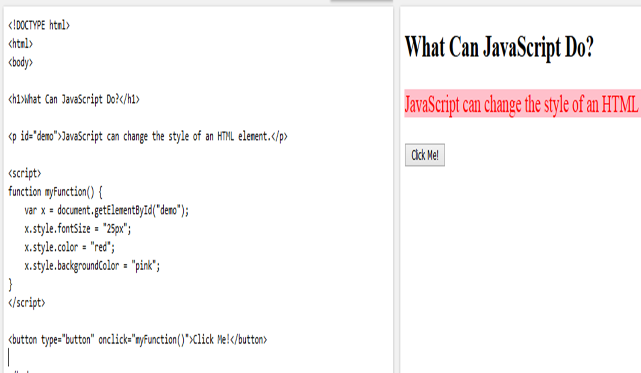
Examples of event handling

Slide 107
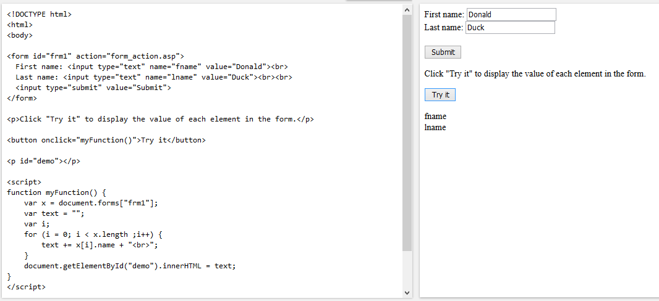
Examples of event handling

Slide 108
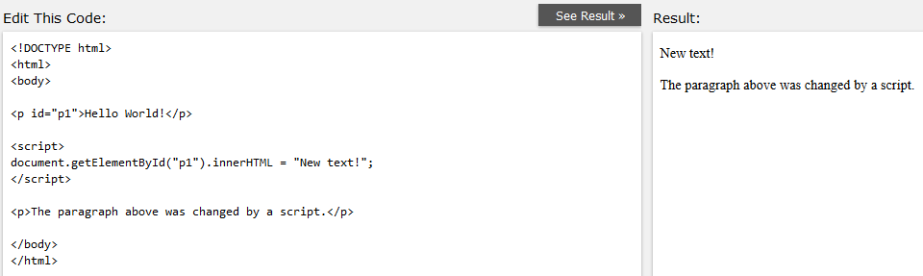
Changing HTML Content

Slide 109
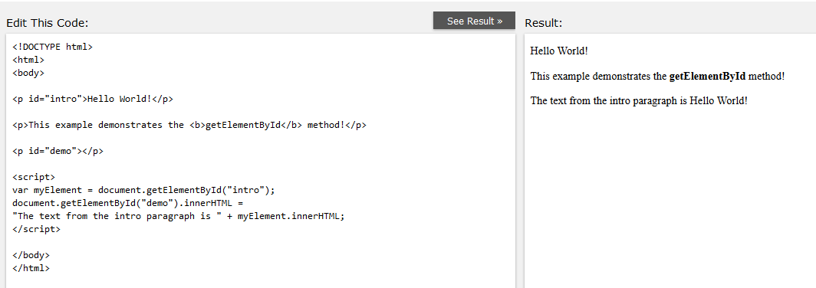
Get html tags as an object

Slide 110
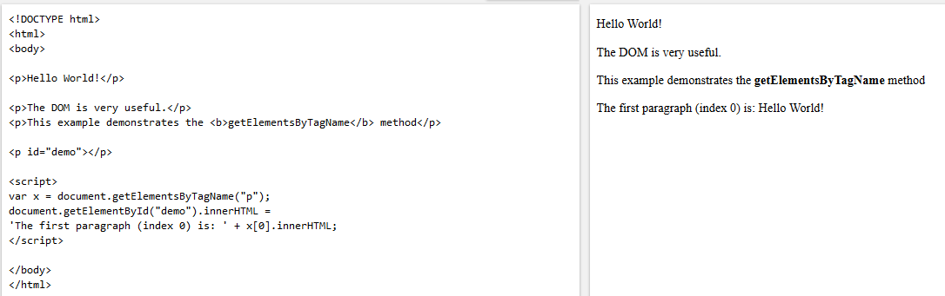
Get elements by tag names

Slide 111
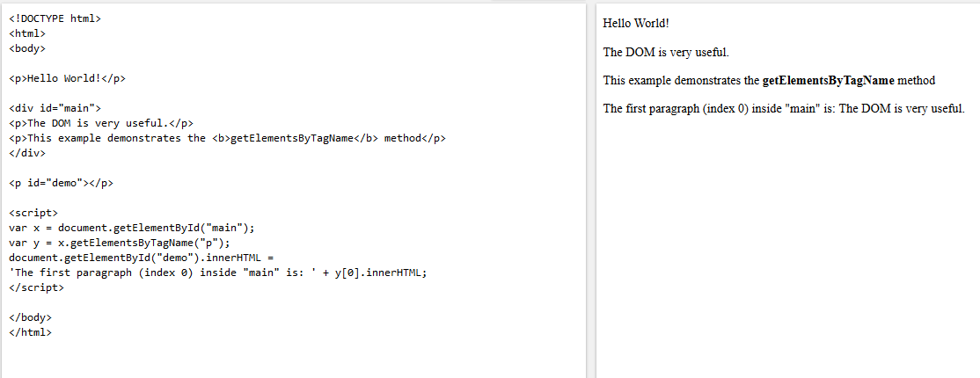
Get a complete Div tag

Slide 112
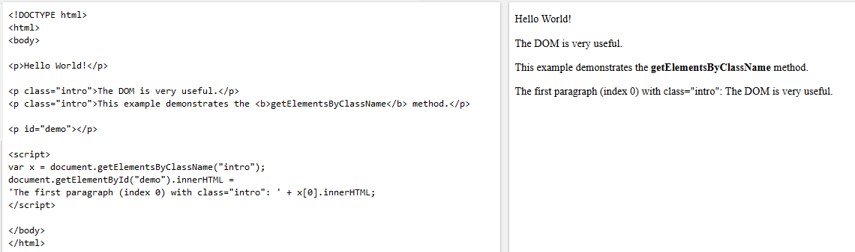
Get elements by class names

Slide 113
Array’s Functions

Slide 114
forEach Method
The forEach() method calls a function for each element in an array.
array.forEach(
function(currentValue, index, array) { //Your logic here }
);
foreach execute a function once for each element through looping
currentValue: The current element being processed in the array.
index (optional): The index of the current element being processed.
array (optional): The array that forEach() was called upon.
foreach do not return any value and do not implement break
const fruits = ['Apple', 'Banana', 'Orange'];
fruits.forEach(function(fruit) {
console.log(fruit);
});

Slide 115
forEach Method
The forEach() method is not executed for empty elements.
let num = [23,45,23,456,56];
num.forEach ((n) => {
console.log(n);
});
Let num = [1,2,3,4,5]
Num.forEach((el, index, arr) => {
arr[index] = el*2; //doubling each number
})
//Here el mean element , index mean element position , array mean full array
Output
[2,4,6,8,10]
let sum = 0; const numbers = [65, 44, 12, 4]; numbers.forEach(myFunction); function myFunction(item) { sum += item; }
numbers.forEach(item =>
console.log(sum+=item);)

Slide 116
map Function
The Javascript map() method in JavaScript creates an array by calling a specific function on each element present in the parent array.
const newArray = array.map(function(currentValue, index, arr) {} );
The callback function can take three arguments (currentValue, index, and array) and return the modified value.
currentValue: The current element being processed in the array.
index (Optional): The index of the current element.
arr: The array that map() was called upon.
The map() always returns a new array of the same length as the original array. It does not modify the original array.

Slide 117
map function Examples
Example-1
const number = [45,63,12,98]
const newArr = numbers.map(function(el){
return el*5
})
console.log(newArr)
Or
const newArr = numbers.map((el) => el*5)
Or
const newArr = numbers.map(multiply)
function multiply(el) {
return el *5;
}
Example-2
const persons = [
{firstName: "Ali", lastName: "Khan"}
{firstName: "Noman", lastName: "Asghar"}
{firstName: "Nadeem", lastName: "Ali"}
]
const fullName = persons.map((el) =>
el.firstName + " " + el.lastName)
console.log(fullName);

Slide 118
filter Function
The filter() method creates a new array filled with elements that pass a test provided by a function.
const newArray = array.filter(function(element) { return /* condition */; });
This method is used for selectively extracting elements from an array based on a given condition.
const number = [1,2,3,4,5,6,7,8]
const greaterThanFive = number.filter(el => el >= 5)
console.log(greaterThanFive)
const names = ["Ali", "Ahsan", "Noman", "Mohsin"]
const filterNames = names.filter(el => el.include('a'))
console.log(filterNames)

Slide 119
find Function
The find() method in JavaScript is used with arrays to retrieve the value of the first element that satisfies a given condition. It executes a provided callback function for each element in the array until a truthy value is returned.
const names = [
{id:1, name:"Ali"},
{id:2, name:"Ahsan"},
{id:3, name:"Noman"},
{id:4, name:"Mohsin"}
]
const foundPerson = names.find(el => el.id === 1)
console.log(foundPerson) // {id:1, name: "Ali"}
const number = [1,2,3,4,5,6,7,8]
const foundNumber = number.find(el => el > 5)
console.log(foundNumber) //Output 6

Slide 120
Difference between filter() & find()
‘filter’ function
The filter function creates a new array with all elements that pass the test implemented by the provided function.
It iterates through each element of the array and applies the provided function to each element.
The provided function should return true to include the element in the new array or false to exclude it.
If no elements pass the test, an empty array is returned.
‘find’ function
The find function returns the first element in the array that satisfies the provided testing function.
It stops once the first matching element is found and returns that element.
If no element satisfies the condition, undefined is returned.
The find function does not create a new array; it just returns the first matching element.

Slide 121
Sort function
The sort() function in JavaScript is used to sort the elements of an array in place (i.e., It modifies the original array).
array.sort(compareFunction);
compareFunction (optional) function defines the sort order. If omitted, JavaScript will sort the array elements as strings provided.
let fruits = ["Banana", "Apple", "Orange", "Mango"];
fruits.sort(); // sorting answer = ["Apple", "Banana", "Mango", "Orange"]
By default fruits values will be sorted according to alphabetically. Similarly number can be sort as
[11,15,12,9,20].sort((a,b)=> a - b )

Slide 122
Sorting Arrays of Objects
Sort by Number Property
const products = [
{ name: "Apple", price: 1.2 },
{ name: "Banana", price: 0.5 },
{ name: "Orange", price: 0.8 }
];
products.sort((a, b) => a.price - b.price);
Here compareFunction will do
- If a - b is negative, a is placed before b.
- If a - b is positive, b is placed before a.
- If a - b is zero, their positions stay unchanged.
Sorting by String Property
const products = [
{ name: "Apple", price: 1.2 },
{ name: "Banana", price: 0.5 },
{ name: "Orange", price: 0.8 }
];
products.sort((a, b) => a.name.localeCompare(b.name));
To sort an array of objects by a string property (e.g., by name),
you can use localeCompare() for string comparison. The
localeCompare() method compares two strings in a case-sensitive
manner based on ..
- A negative number if the first string comes before the second.
- Zero if they are equal.
A positive number if the first string comes after the second.
Another Method by Using Simple String Comparison (<, >)
products.sort((a, b) => a.name > b.name ? 1 : (a.name < b.name ? -1 : 0));
- If a.name is greater than b.name, it returns 1, meaning a should come after b.
- If a.name is less than b.name, it returns -1, meaning a should come before b.
- If a.name is equal to b.name, it returns 0, meaning their relative order remains unchanged.

Slide 123
reduce Function
The reduce() method in JavaScript is used to apply a function to all elements of an array and accumulate a single value. The function has the following syntax:
function callbackFn( previousValue, currentValue, currentIndex, array ) { /**/ }
previousValue:- The value returned from the previous call of the callbackFn function. On the first call, the initialValue is the previousValue.
currentValue:- The value of the current array element. On the first call, it is array[0].
currentIndex:- The index of the currentValue in the array.
array:- The array to loop through.

Slide 124
Examples
Grouping Objects by a Property:
const students = [
{ name: 'Alice', age: 20 },
{ name: 'Bob', age: 21 },
{ name: 'Charlie', age: 20 },
{ name: 'Dave', age: 22 }
];
const groupedByAge = students.reduce(
(accumulator, currentValue) => {
const age = currentValue.age;
if (!accumulator[age]) {
accumulator[age] = [];
}
accumulator[age].push(currentValue);
return accumulator; }, {}
);
console.log(groupedByAge);
// Output: { 20: [ { name: 'Alice', age: 20 },
{ name: 'Charlie', age: 20 }],
21: [ { name: 'Bob', age: 21 }],
22: [ { name: 'Dave', age: 22 }]
}
Summing an Array:
const numbers = [1, 2, 3, 4, 5];
const sum = numbers.reduce((accumulator, currentValue)
=> accumulator + currentValue);
console.log(sum); // Output: 15
Finding the Maximum Value in an Array:
const values = [10, 5, 8, 20, 3];
const max = values.reduce((accumulator, currentValue)
=> Math.max(accumulator, currentValue));
console.log(max); // Output: 20
Flattening an Array of Arrays:
const nestedArray = [[1, 2], [3, 4], [5, 6]];
const flattened = nestedArray.reduce((accumulator, currentValue)
=> [...accumulator, ...currentValue], []);
console.log(flattened); // Output: [1, 2, 3, 4, 5, 6]

Slide 125
Exercises
Write a JavaScript function to reverse the elements of an array.
function reverse(arr){
const reversedArr = []
arr.forEach(el => {
reversedArr.unshift(el) })
return reversedArr
}
console.log(reverse([1,2,3,4,5]))
Write a JavaScript function to get the first element of an array.
passing a parameter 'n' will return the first 'n' elements of the array.
function getFe(arr,n){
if(!n) return arr[0]
return arr.slice(0,n)
}
Sample Input
console.log(getFe([7,8,9], 3))

Slide 126
Excercise
Write a JavaScript program that adds an element to cart. if the element is already in cart then it should return
an error saying item is already in card.
Sample Input
console.log(addToCart([1,2,3],4))
console.log(addToCart([1,2,3],3))
Sample Output
New Item "4" added successfully
Item "3" already in Cart
Solution
function addToCart(cart,el){
if(cart.includes(el)){
return console.log("Item ${el} already in Cart")
}
cart.push(el)
console.log("New item ${el} added successfully")
}
console.log(addToCart([1,2,3],4))
console.log(addToCart([1,2,3],3))

Slide 127
Spread
The JavaScript spread operator ( ... ) allows us to quickly copy all or part of an existing array or object into another array or object.
Example-1
const numbersOne = [1, 2, 3];
const numbersTwo = [4, 5, 6];
const combined = [...numbersOne, ...numbersTwo];
console.log(combined); // 1,2,3,4,5,6
Example-3
//Combine two objects:
const myVehicle = {
brand: 'Ford',
model: 'Mustang',
color: 'red' }
const updateMyVehicle = {
type: 'car',
year: 2021,
color: 'yellow' }
const myVehicle = {...myVehicle, ...updateMyVehicle}
Example-2
const numbers = [1, 2, 3, 4, 5, 6];
//Assign the first and second items from numbers variables
//and put the rest in an array:
const [one, two, ...rest] = numbers;
console.log(one); // 1
console.log(two); // 2
console.log(rest); // 3, 4, 5, 6

Slide 128
Rest
The rest operator in JavaScript allows a function to take an indefinite number of arguments and bundle them in an array.
function fname(a,b,...myRest) {
//statements
}
Here, a and b are normal parameters which will map to first and second argument respectively. Whereas myRest is the rest parameter, that will contain contains the third, fourth, and fifth ... nth arguments i.e all the remaining arguments other than the values of a and b.
function addition(...myArgs) {
let sum = 0;
for (let i of myArgs)
sum += i;
return sum;
}
console.log(addition(5, 6));
console.log(addition(5, 6, 7));
console.log(addition(5, 6, 7, 8, 9));
const toArray = (…args) => {
return args;
}
console.log(toArray(1,2,3,4));

